Slide 1
COMP28112 Lecture 3
Architectures of distributed systems
Fundamental Models

Slide 2
Architectures of Distributed Systems
Tightly coupled
  Highly integrated machines that may look as a single computer.
Loosely coupled (share nothing)
  Client-Server
  Peer-to-Peer
  A Key differentiation based on the Programming Interface:
    Distributed Objects
    Web Services
    Read “Web Services are not Distributed Objects”, Internet Computing, Nov-Dec. 2003, http://www.allthingsdistributed.com/historical/archives/000343.html

Slide 3
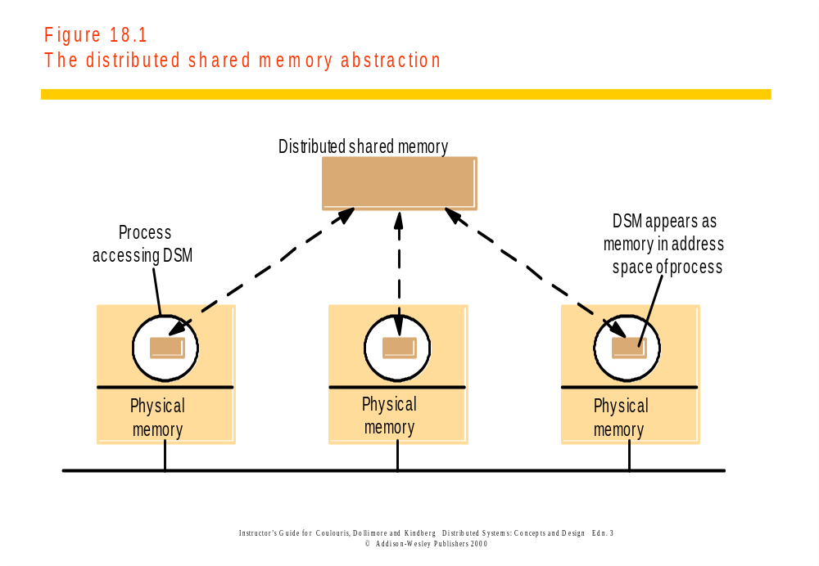
Tightly coupled systems
Distributed shared memory (DSM)provides the illusion of a single shared memory: it spares the programmer the concerns of message passing.

Slide 4
Issues with Distributed Shared Memory
Machines are still connected by a network:
  Minimize network traffic
  Reduce the latency between request and completion
How to keep track of the location of shared data
How to overcome delays when accessing remote data
How to make shared data concurrently accessible
Replicate shared data on multiple machines:
  Need memory coherence
Lots of research in the context of building parallel computers – see Chapter 18 in Coulouris et al book.

Slide 5
Architectural Styles
(talking about loosely-coupled systems)
Based on the logical organization of the components of distributed systems:
Layered architectures
Object-based architectures
Data-centered architectures
Event-based architectures

Slide 6
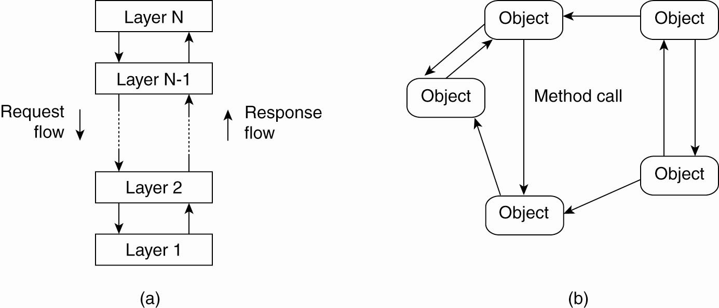
The layered architectural style
See Figure 2-1 in Tanenbaum and Van Steen book

Slide 7
The object-based architectural style
See Figure 2-1 in Tanenbaum and Van Steen book

Slide 8
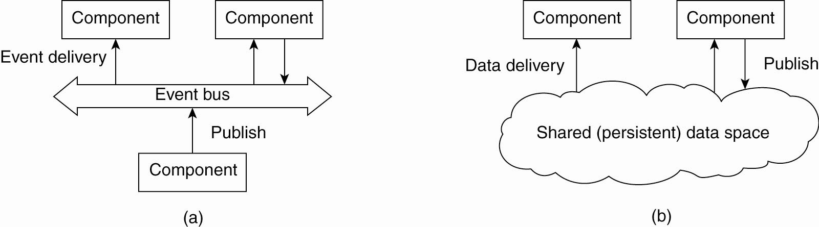
The Event-Based architectural style
See Figure 2-2 in Tanenbaum and Van Steen book

Slide 9
Shared-Data Space Architectural Style
See Figure 2-2 in Tanenbaum and Van Steen book

Slide 10
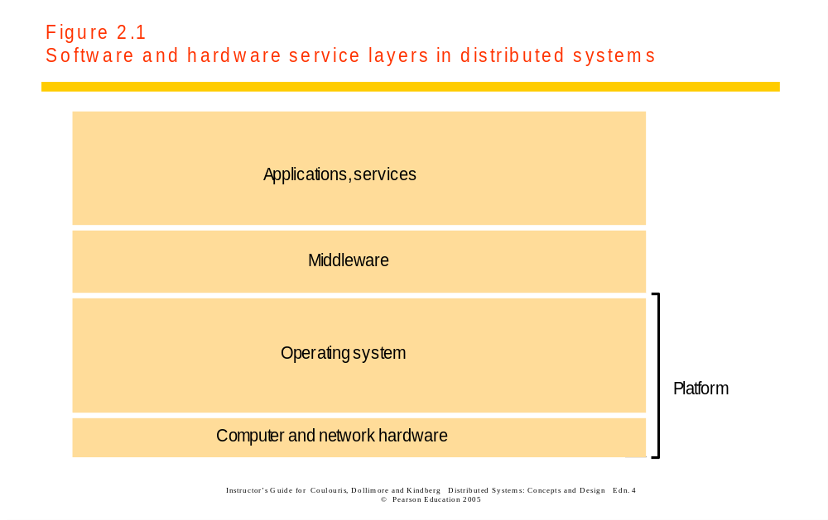
System Architectures of Distributed Systems

Slide 11
Middleware
Middleware: a software layer that provides a programming abstraction to mask the heterogeneity of the underlying platforms (networks, languages, hardware, …)
  E.g., CORBA, Java RMI
But… the end-to-end argument implies that some aspects of communication support cannot always be abstracted away from applications.

Slide 12
The end-to-end argument
“The function in question can completely and correctly be implemented only with the knowledge and help of the application standing at the end points of the communication system. Therefore, providing that questioned function as a feature of the communication system itself is not possible. (Sometimes an incomplete version of the function provided by the communication system may be useful as a performance enhancement.)”
See Coulouris pages 33-34 and http://www.reed.com/dpr/locus/Papers/EndtoEnd.html

Slide 13
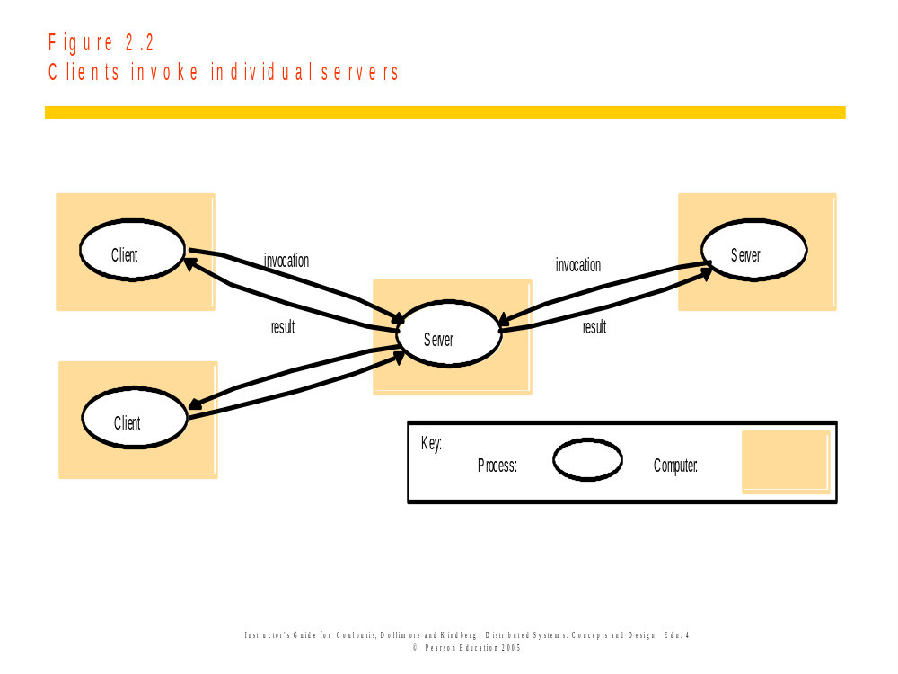
Client-Server Model

Slide 14
Client-Server Model
Characteristics of a server:
  Passive (slave)
  Waits for requests
  Upon receipts of requests, it processes them and sends replies
  Can be stateless (does not keep any information between requests) or stateful (remembers information between requests)
Characteristics of a client:
  Active (master)
  Sends requests
  Waits for and receives server replies

Slide 15
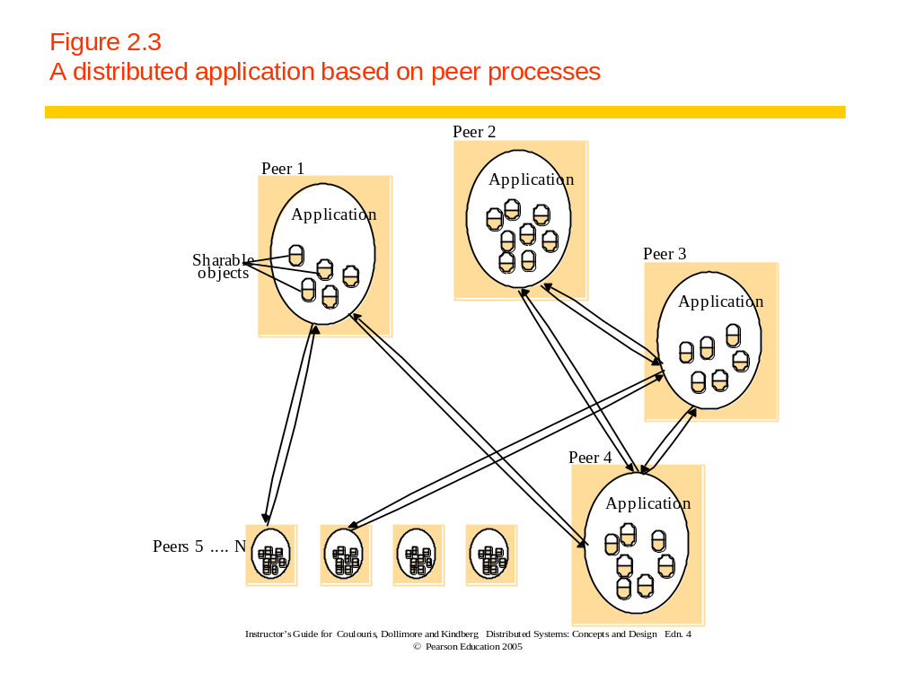
Peer-to-Peer (P2P)
Earlier Example:
Usenet News
Other examples:
Napster, Gnutella,
Freenet, …

Slide 16
Client-Server vs P2P
Client-Server
  Widely Used
  Functional Specialisation
  Asymmetrical
  Tends to be centralised
  Tends to scale poorly
P2P
  Symmetrical, computers have same “rights”
  Truly Distributed
  Share / exploit resources with a large number of participants
  Resource discovery is a challenge

Slide 17
Variations on a theme…
Sometimes we need to consider:
  The use of multiple servers to increase performance and resilience
  The use of mobile code
  Users’ need for low-cost computers
  Requirements to add and remove mobile devices

Slide 18
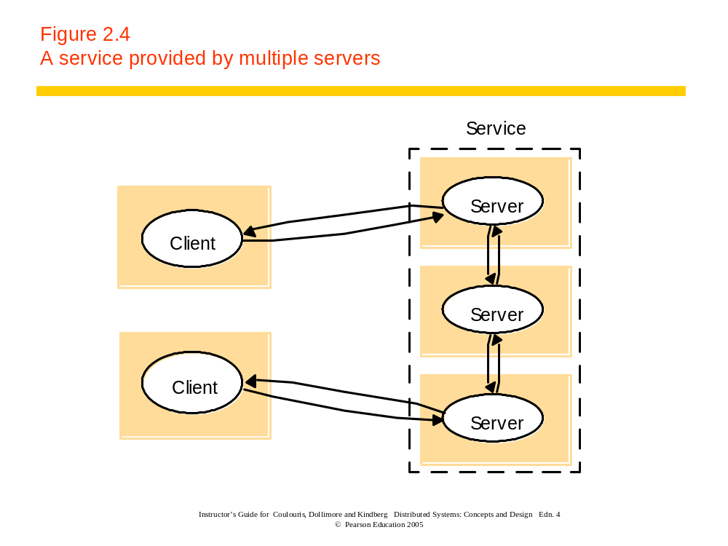
Multiple Servers

Slide 19
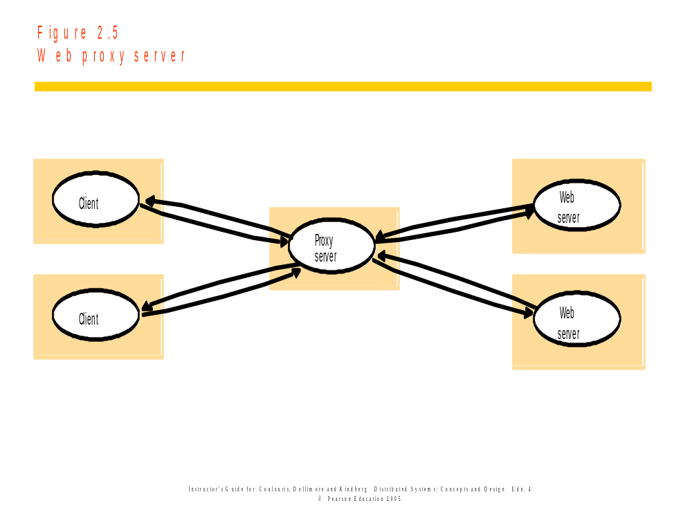
Proxies and Caches

Slide 20
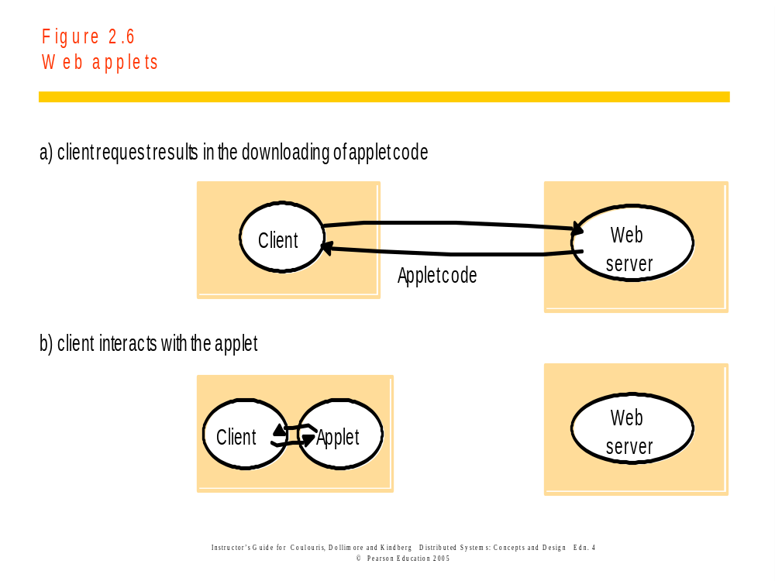
Mobile Code…

Slide 21
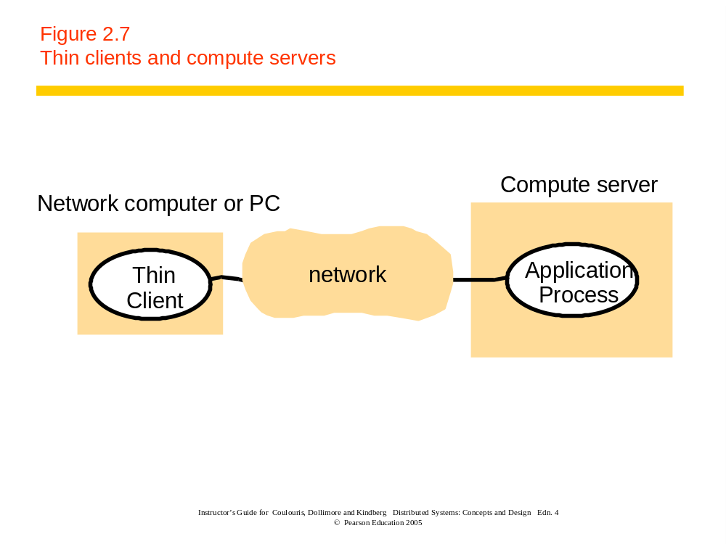
Thin Clients

Slide 22
Design Requirements
Performance
  Responsiveness
  Throughput
  Load balancing
Quality of Service
Caching and Replication
Dependability
  Correctness
  Security
  Fault-Tolerance

Slide 23
Fundamental Models
Models include all the essential ingredients that we need to consider in order to understand and reason about some aspects of a system’s behaviour.
A way of abstracting from reality.
Aspects that we need to capture include:
  Process Interaction
  Failure
  Security
Managing concurrency and failure underlies many of the problems we face!

Slide 24
Factors affecting process interaction
Performance of communication channels
Computer Clocks and Timing Events
Two variants of the process interaction model:
  Synchronous systems:
    Process Execution Speeds: has known lower and upper bound
    Message transmitted delay: bounded
    Clock drift rates: drift rate from real time has a known bound
  Asynchronous systems:
    All the above may take an arbitrarily long time.

Slide 25
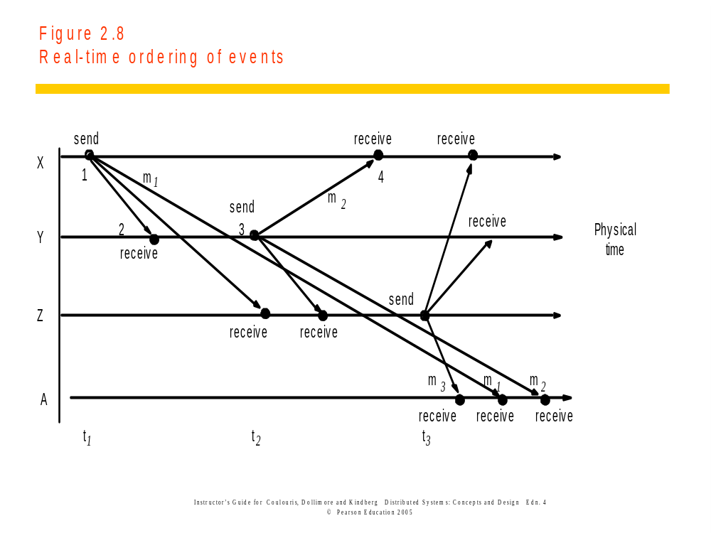
Event Ordering

Slide 26
Failures in distributed systems
What can go wrong?
  (see Figure 2.10 in Coulouris)
How to mask failures?
  Read about checksums in network protocols

Slide 27
In Summary...
Different Architectures have different solutions
Managing Concurrency, Failures, and Security underlies many of the problems we face.
Reading:
  Coulouris (4th or 5th edition), Chapter 2; Tanenbaum, Sec. 2.1, 2.2 (skim through the rest of Chapter 2)
  Read the text associated with the figures from Coulouris et al and Tanenbaum et al textbooks that are shown in this handout.
Next time: Remote procedure calls.

